Slide 1
Chapter 3 figures

Slide 2
7.5 mm
3 mm
100 nm Ge
30 nm SiNx
500 μm Si
7.5 mm
3 mm
100 nm Ge
30 nm SiNx
500 μm Si
Notes:
Sample_Geometry.png

Slide 3
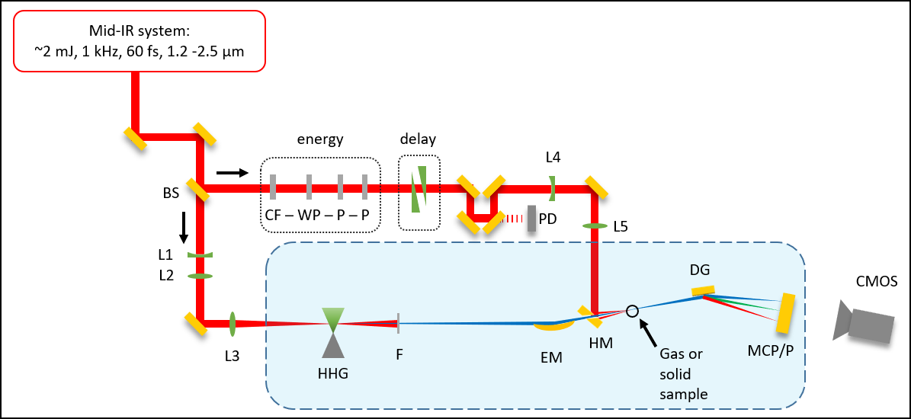
Beamline cartoon (image)
S
S

Slide 4

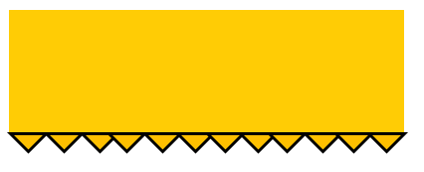

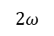
Beamline cartoon (editable)
Mid-IR system:
~2 mJ, 1 kHz, 60 fs, 1.2 -2.5 μm
energy
delay
S
L4
BS
CF – WP – P – P
PD
L5
S
L1
DG
L2
CMOS
I
L3
$$2ω$$
F
EM
HM
SH
MCP/P
HHG

Slide 5
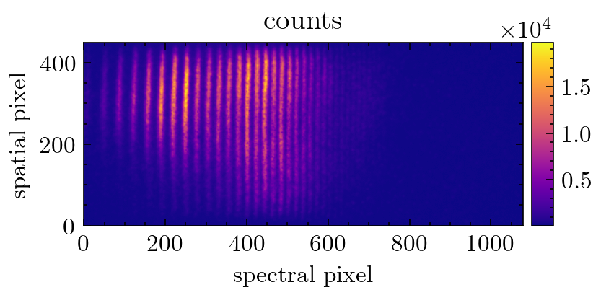
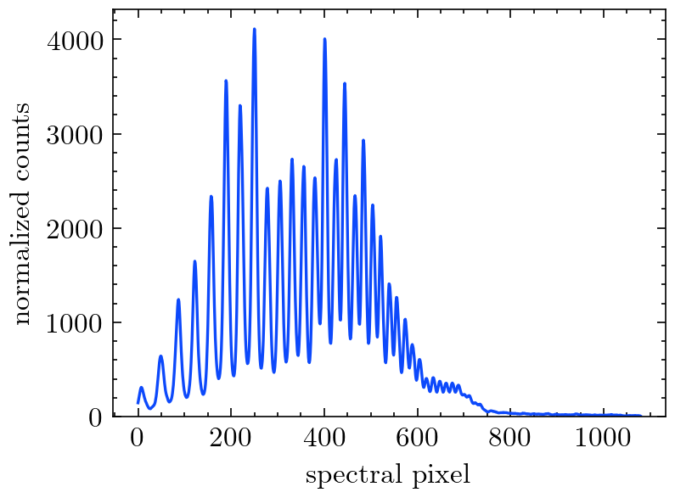
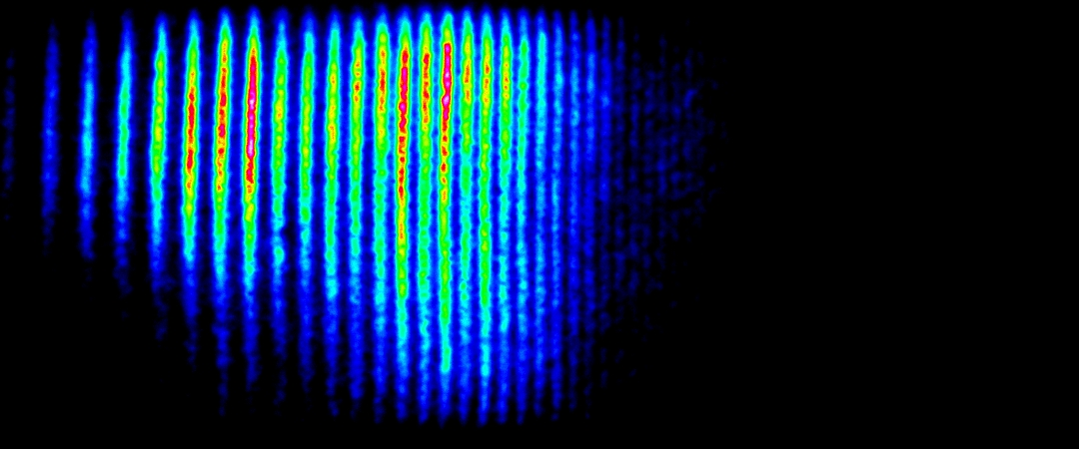
2D spectrometer image
Raw 2D image
Spectral lineout
Filtering
Delta-OD calculation
Delta-OD normalization
Average delta-OD
Energy calibration
Background subtraction, exposure time normalization, normalized spatial integration,

Slide 6
Imaging the samples under vacuum
C
1 inch
FM
HM
SH
1 inch
L

Slide 7
Finding temporal overlap in vacuum (or vented)
PA
FM
HM
SH
GA
L
C

Slide 8
Si, 260 nm
Si, one hole <200μm
“popped” 30 nm SiN

Slide 9
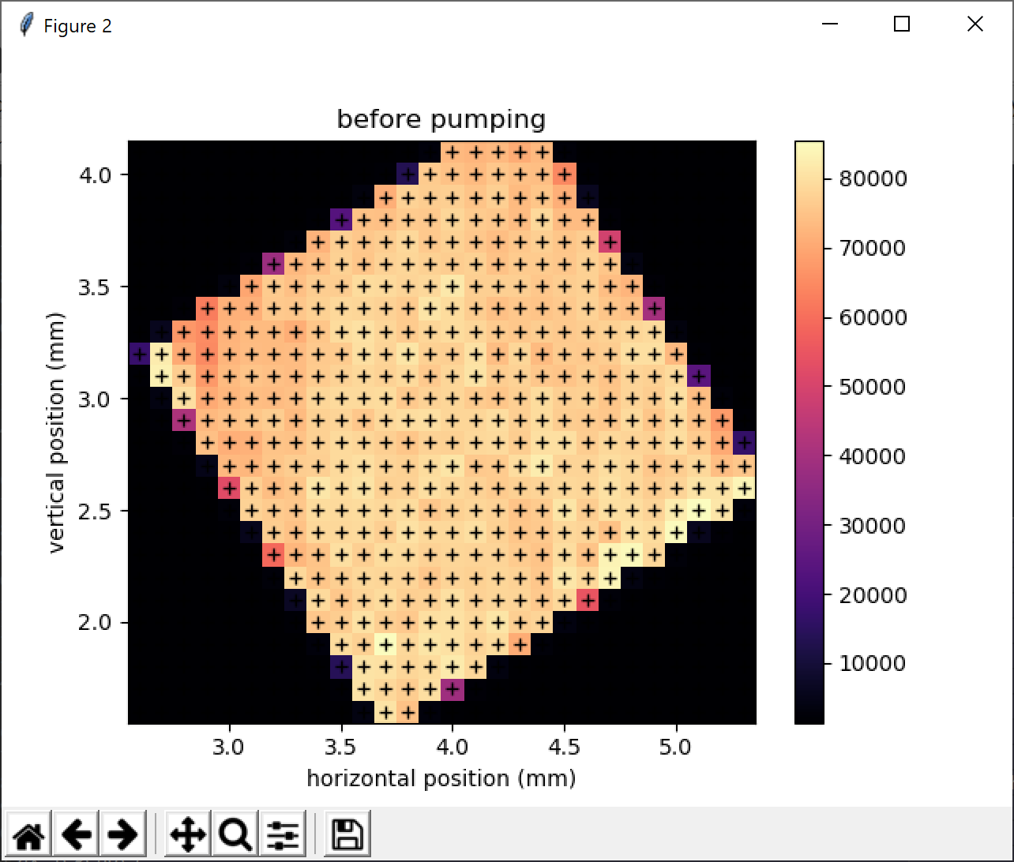
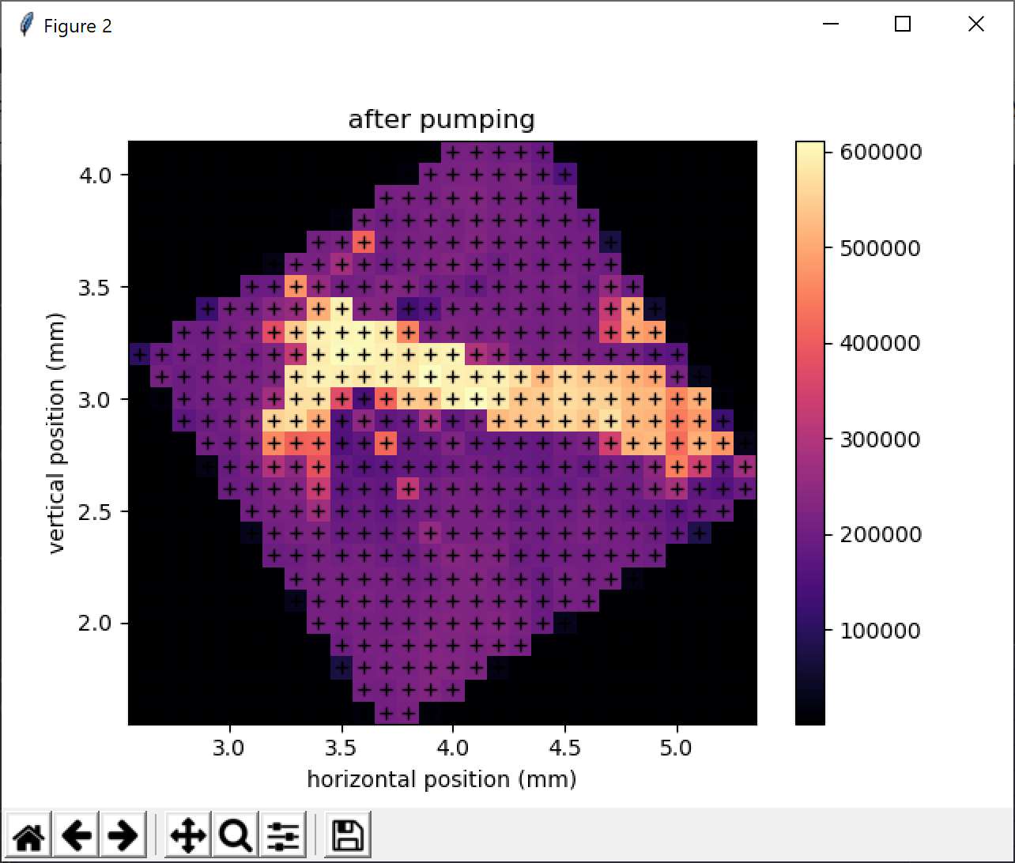
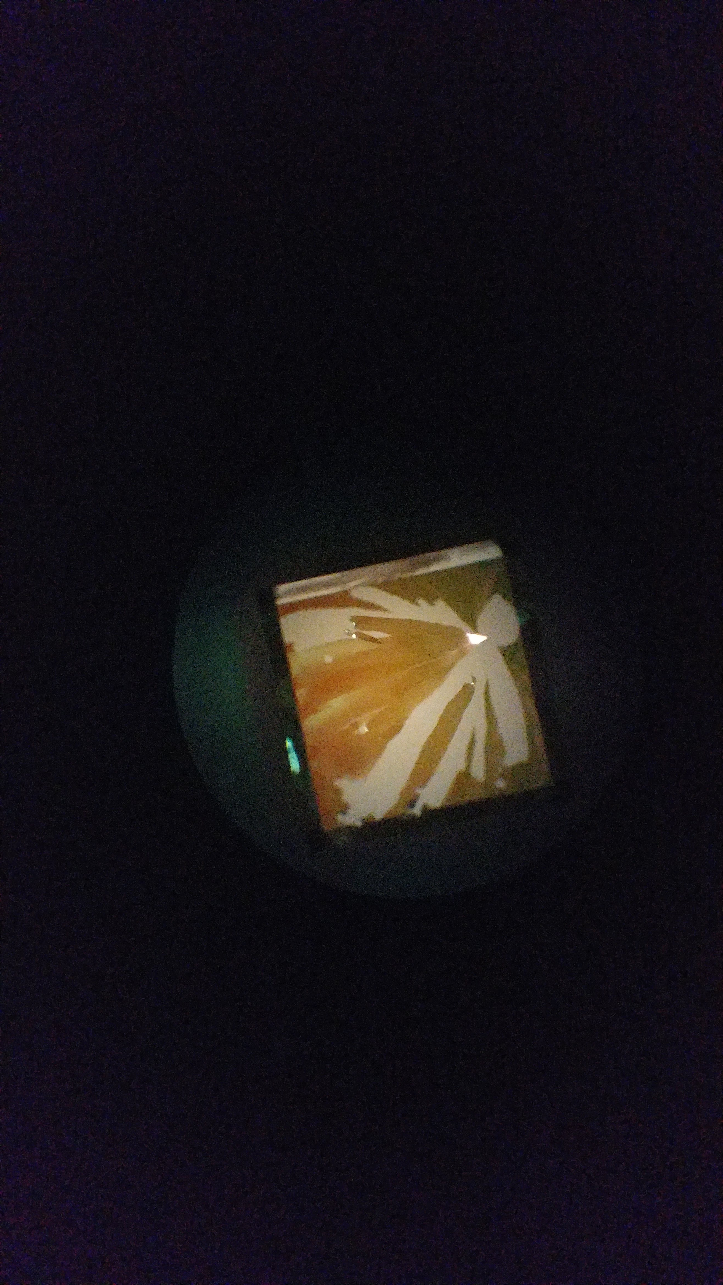
200 nm Si
200 nm Si
200 nm Si
IR-pumped areas
microscope image
Notes:
Figures from 2019-04-19 powerpoint presentation … “before pumping” was 4/09/2019 map1. “after pumping” was 4/10/2019 map1.

Slide 10
Si, 260 nm
Si, one hole <200μm
“popped” 30 nm SiN
200 nm Si
200 nm Si
200 nm Si
IR-pumped areas
microscope image
Notes:
Figures from 2019-04-19 powerpoint presentation … “before pumping” was 4/09/2019 map1. “after pumping” was 4/10/2019 map1.

Slide 11
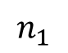
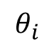
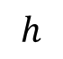
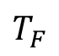
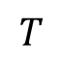
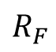
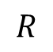
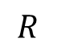
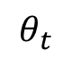
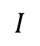
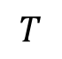
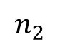
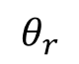
Fresnel geometry
a)
b)
$$h$$
$$I$$
interface
$$T$$
$$T_{F}$$
$$θ_{i}$$
normal
$$θ_{r}$$
$$θ_{t}$$
$$R$$
$$R$$
$$T$$
$$R_{F}$$
$$n_{1}$$
$$n_{2}$$

Slide 12
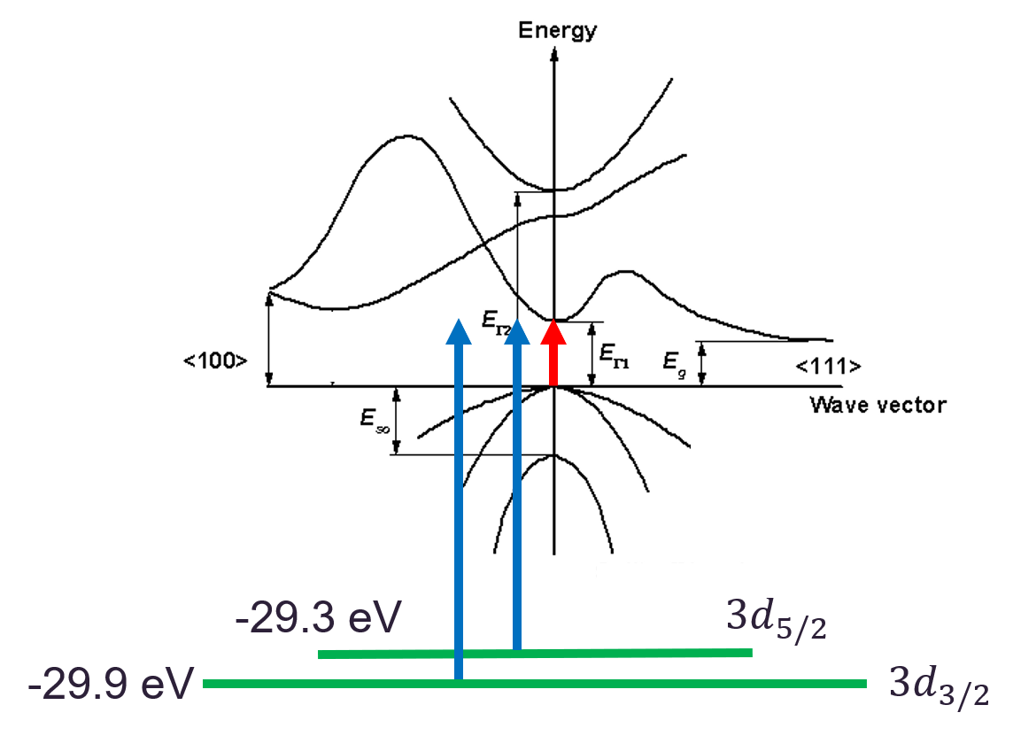

Slide 13
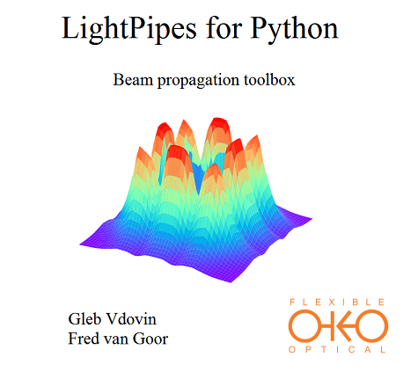
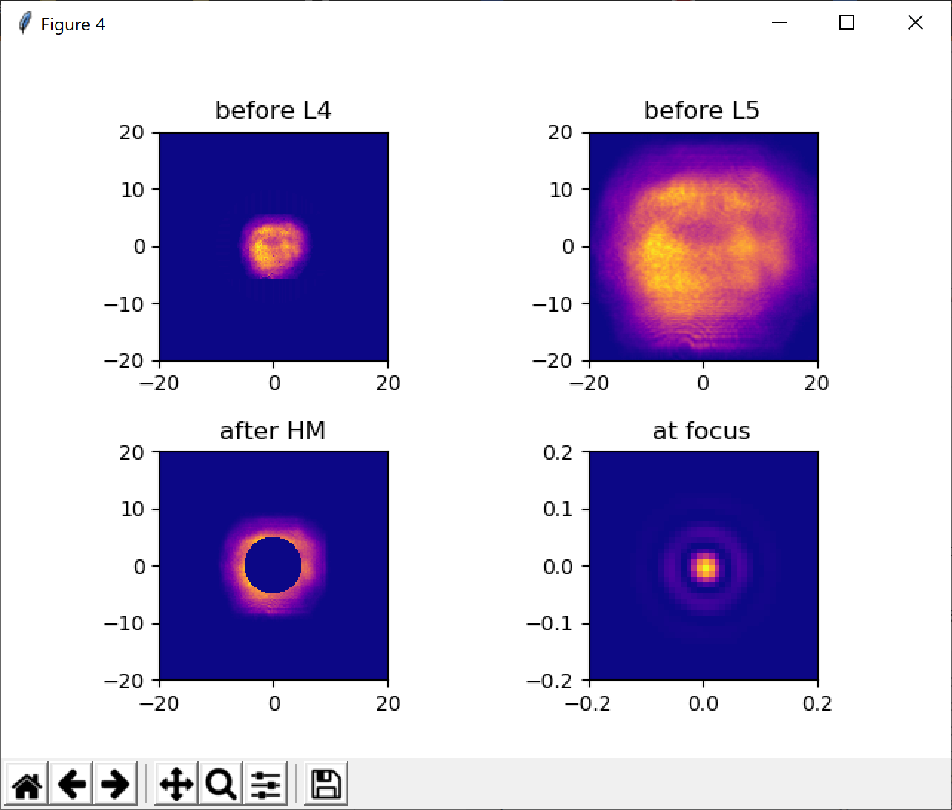
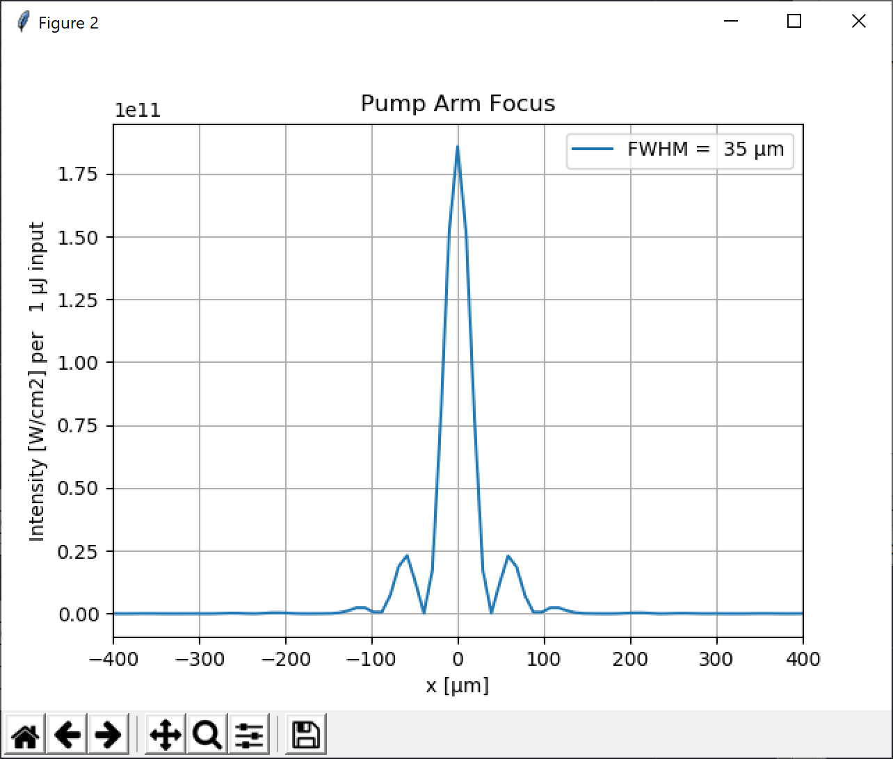
$$λ=1.5 μm$$
Notes:
20 mW = 20 mJ = 3.6 * 10^12 W/cm2
35 mJ = 6.3 * 10^12 W/cm2

Slide 14
Knife edge cartoon
XUV
XUV detector

Slide 15
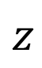
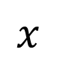
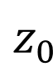
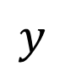
Knife edge cartoon
$$y$$
EM
$$z$$
$$x$$
XUV
XUV detector
$$z_{0}$$

